Slide 1
Forces
Physics
Unit 2
Notes:
NAD 2023 Standards – Physical Science Force F1 (Newton’s Laws)

Slide 2
Credits
This Slideshow was developed to accompany the textbook
  OpenStax High School Physics
    Available for free at https://openstax.org/details/books/physics
    By Paul Peter Urone and Roger Hinrichs
    2020 edition
Some examples and diagrams are taken from the OpenStax College Physics, Physics, and Cutnell & Johnson Physics 6th ed.
Slides created by
Richard Wright, Andrews Academy
rwright@andrews.edu

Slide 3
2-01 Newton’s Laws of Motion
After this lesson you will…
Know Newton’s Laws of Motion
Draw a freebody diagram
Apply Newton’s Second Law of Motion
F = ma
Notes:
OpenStax High School Physics 4.1-4.4
OpenStax College Physics 2e 4.1-4.4

Slide 4
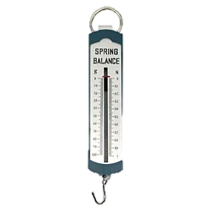
2-01 Newton’s Laws of Motion
F = ma
Kinematics
  How things move
Dynamics
  Why things move
Force
  A push or a pull
  Is a vector
  Unit: Newton (N)
  Measured by a spring scale

Slide 5
2-01 Newton’s Laws of Motion
F = ma
Free-body diagram
  Picture of object with all the forces acting on the object

Slide 6
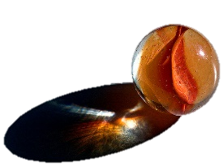
2-01 Newton’s Laws of Motion
F = ma
Place a marble on your desk so that it is at rest (not moving).
Observe the marble for a minute. What happens to it?
Without applying a force to the marble, make it move. Remember gravity is a force, so tipping the desk is the same as applying a force. Were you able to move the marble?
Roll the marble across your desk at a moderate speed so that it has no sidewise spin. Describe the path the marble took.
Without a sidewise spin, tipping the desk, or applying a force, can you make the marble take a curved path?
Notes:
2. Nothing
3. No
4. Straight
5. No

Slide 7
2-01 Newton’s Laws of Motion
F = ma
Newton’s First Law of Motion
A body at rest remains at rest, or, if in motion, remains in motion at a constant velocity unless acted on by a net external force.
Inertia
  Property of objects to remain in constant motion or rest.
  Mass is a measure of inertia
Watch Eureka! 01
Watch Eureka! 02
Notes:
Example: Ice hockey, puck sits until someone hits it. Then it goes straight.

Slide 8
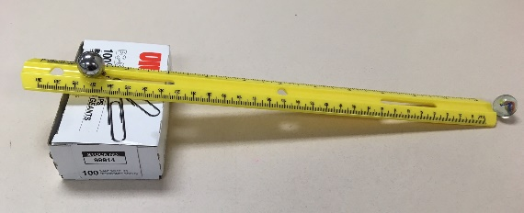
2-01 Newton’s Laws of Motion
F = ma
Make a ramp using the grooved ruler and a book.
Place a glass marble on your desk at the end of the ramp.
Release the other glass marble from the top of the ramp so that it rolls and hits the marble on the desk. Observe the velocity of the marble that was on the desk.
Place a glass marble on the desk at the end of the ramp.
Release the metal marble from the top of the ramp so that it rolls and hits the metal marble on the desk. Observe the velocity of the metal marble.
Which marble on the desk (1st or 2nd) had a larger force applied to it?
Which marble had the larger final velocity?
What was the marble’s initial velocity in both cases?
Define acceleration.
Which marble had the larger acceleration?
What is the relationship between force and acceleration?
Notes:
6. 2nd
7. 2nd
8. 0
9. $a=\frac{Δv}{Δt}$
10. 2nd
11. Bigger force = bigger acceleration

Slide 9
2-01 Newton’s Laws of Motion
F = ma
Place a glass marble on your desk at the end of the ramp.
Release the other glass marble from the top of the ramp so that it rolls and hits the marble on the desk. Observe the velocity of the marble that was on the desk.
Place a metal marble on the desk at the end of the ramp.
Release the glass marble from the top of the ramp so that it rolls and hits the metal marble on the desk. Observe the velocity of the metal marble.
Which marble on the desk (glass or metal) had a larger force applied to it?
Which marble had the larger final velocity?
Which marble had the larger acceleration?
Which marble had more mass?
What is the relationship between mass and acceleration?
Notes:
5. Same
6. Glass
7. Glass
8. Metal
9. Bigger mass = smaller acceleration

Slide 10
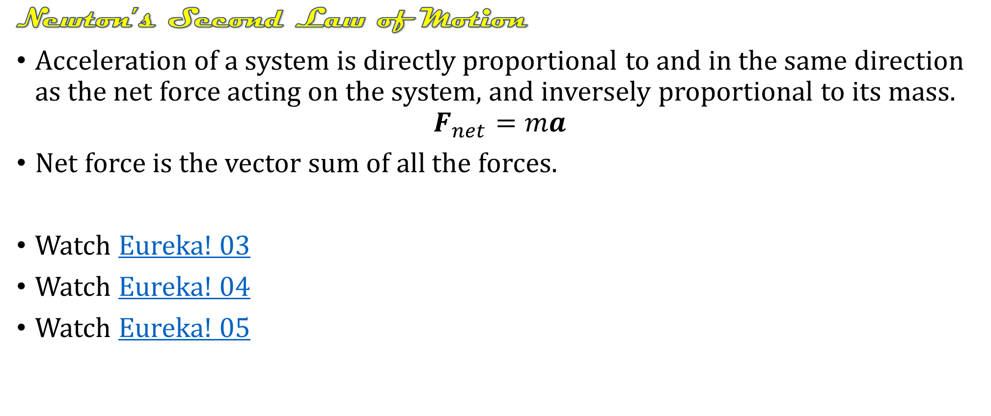
2-01 Newton’s Laws of Motion
F = ma
Newton’s Second Law of Motion
Acceleration of a system is directly proportional to and in the same direction as the net force acting on the system, and inversely proportional to its mass.
$$F_{net}=ma$$
Net force is the vector sum of all the forces.
Watch Eureka! 03
Watch Eureka! 04
Watch Eureka! 05

Slide 11
2-01 Newton’s Laws of Motion
F = ma
Take two spring scales and hook their ends together. Lay them horizontally on the desk.
Gently pull on one spring scale so it reads 4 N.
What do the scales read for the force?
Apply 3-N force. What do the scales read?
With the scales hooked together, try to pull only one scale so that the other one does not experience a force. Were you successful, explain.
Notes:
3. 4 N, 4 N
4. 3 N, 3 N
5. No (there is some friction involved in the spring scales and that can cause unequal force readings)

Slide 12
2-01 Newton’s Laws of Motion
F = ma
Newton’s Third Law of Motion
Whenever one body exerts a force on a second body, the first body experiences a force that is equal in magnitude and opposite in direction to the force that it exerts.
Every force has an equal and opposite reaction force.
You push down on your chair, so the chair pushed back up on you.

Slide 13
2-01 Newton’s Laws of Motion
F = ma
A football player named Al is blocking a player on the other team named Bob. Al applies a 1500 N force on Bob. If Bob's mass is 100 kg, what is his acceleration?
What is the size of the force on Al?
If Al's mass is 75 kg, what is his acceleration?
Notes:
$$F=ma$$
$$1500 N=\left(100 kg\right)a→a=15 m/s^{2}$$
1500 N (Newton’s 3rd Law)
$$F=ma$$
$$1500 N=\left(75 kg\right)a→a=20 m/s^{2}$$

Slide 14

2-01 Newton’s Laws of Motion
F = ma
A 0.046 kg golf ball hit by a driver can accelerate from rest to 67 m/s in 1 ms while the driver is in contact with the ball. How much average force does the golf ball experience?
Notes:
$$v=at+v_{0}$$
$$67\frac{m}{s}=a\left(1×10^{−3} s\right)+0$$
$$67000\frac{m}{s^{2}}=a$$
$$F=ma$$
$$F=\left(0.046 kg\right)\left(67000\frac{m}{s^{2}}\right)$$
$$F=3082 N$$

Slide 15
2-02 Weight and Normal Force
After this lesson you will…
Apply Newton’s Laws with weight and normal force
Solve force problems on inclined planes
F = ma
Notes:
OpenStax High School Physics 4.1-4.2
OpenStax College Physics 2e 4.3-4.5

Slide 16
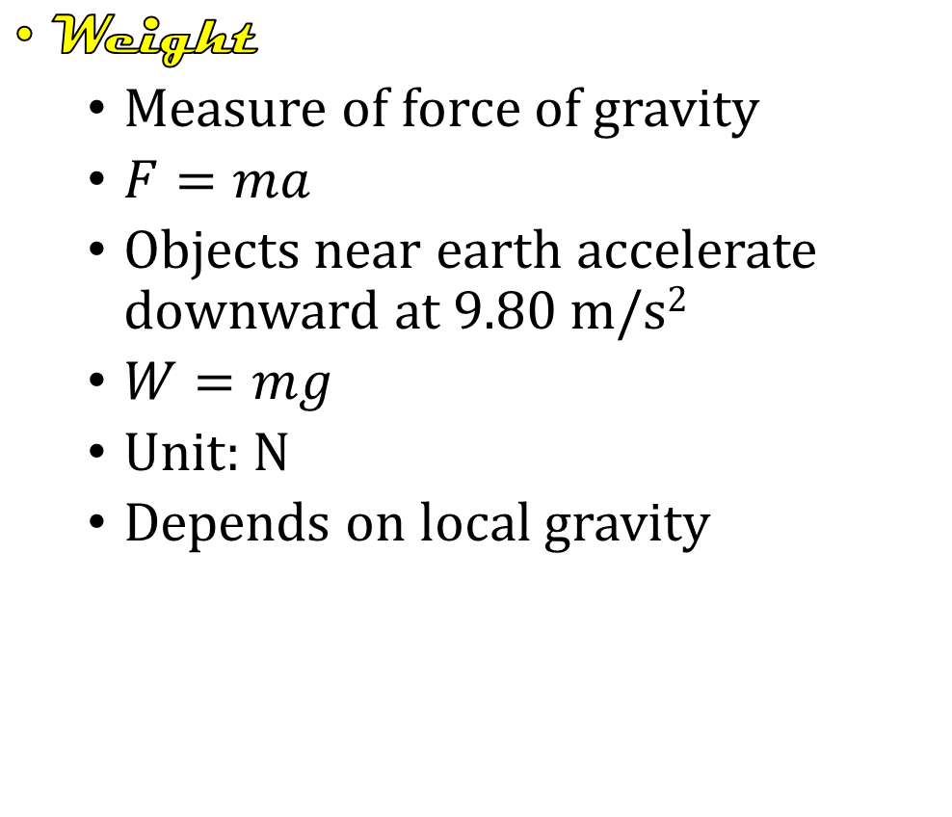
2-02 Weight and Normal Force
F = ma
Weight
  Measure of force of gravity
  $F=ma$
  Objects near earth accelerate downward at 9.80 m/s²
  $W=mg$
  Unit: N
  Depends on local gravity
Mass
  Not a force
  Measure of inertia or amount of matter
  Unit: kg
  Constant
Watch Eureka! 6
Remember!!!
  Weight is a Force
Watch Eureka 7

Slide 17

2-02 Weight and Normal Force
F = ma
Problems-Solving Strategy
Identify the principles involved and draw a picture
List your knowns and Draw a free-body diagram
Apply $F_{net}=ma$
Check your answer for reasonableness

Slide 18
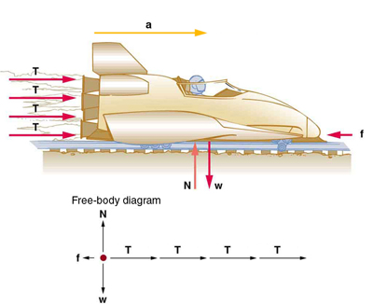
2-02 Weight and Normal Force
F = ma
Free-body diagram
  Draw only forces acting on the object
  Represent the forces with vector arrows

Slide 19
2-02 Weight and Normal Force
F = ma
When two objects touch there is often a force
Normal Force
  Perpendicular component of the contact force between two objects
F_{N}

Slide 20
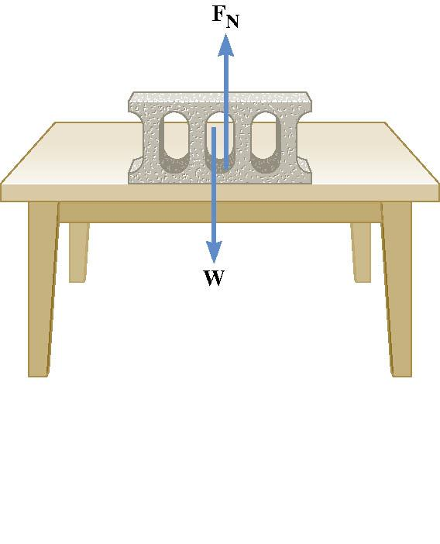
2-02 Weight and Normal Force
F = ma
Weight pushes down
So the table pushes up
  Called Normal force
  Newton’s 3rd Law
Normal force doesn’t always = weight
Draw a freebody diagram to find equation

Slide 21
2-02 Weight and Normal Force
F = ma
A 30-kg box of books is sitting on the floor. A 20-kg child is sitting on the box. What is the normal force between the child and the box?
What is the normal force between the box and the floor?
Notes:
$$F=ma$$
$$F_{N}−mg=0$$
$$F_{N}−\left(20 kg\right)\left(9.8\frac{m}{s^{2}}\right)=0$$
$$F_{N}=196 N$$
$$F=ma$$
$$F_{N}−mg=0$$
$$F_{N}−\left(50 kg\right)\left(9.8\frac{m}{s^{2}}\right)=0$$
$$F_{N}=490 N$$

Slide 22
2-02 Weight and Normal Force
F = ma
Hang the mass from the spring scale. The scale will measure the force applied to hold the mass in place. This is the weight.
What is the weight of your mass?
Carefully watch the spring scale as you quickly move the scale upwards. What happens to the weight?
Carefully watch the spring scale as you quickly move the scale downwards. What happens to the weight?
The other weights are called apparent weight and is what you feel as the net force pulling you down. An upward acceleration produces a _______________________ apparent weight. A downward acceleration produces a ______________________ apparent weight.
When a problem asks for apparent weight, find the normal force
Notes:
3. More
4. Less
5. larger; smaller

Slide 23
2-02 Weight and Normal Force
F = ma
A lady is weighing some bananas in a grocery store when the floor collapses. If the bananas mass is 2 kg and the floor is accelerating at −2.25 m/s², what is the apparent weight (normal force) of the bananas?
F_{N} = 15.1 N
Notes:
Draw freebody diagram and solve
$$F_{net}=F_{N}−w=ma$$
$$F_{N}−\left(2 kg\right)\left(9.8\frac{m}{s^{2}}\right)=\left(2 kg\right)\left(−2.25\frac{m}{s^{2}}\right)$$
$$F_{N}=15.1 N$$

Slide 24
2-02 Weight and Normal Force
F = ma
A box is sitting on a ramp angled at 20°. If the box weighs 50 N, what is the normal force on the box?
47 N
F_{N}
20°
20°
w
Notes:
$$w_{⊥}=w⋅\cos{20°}=47 N$$
$$F_{N}−w_{⊥}=ma=0$$
$$F_{N}=w_{⊥}=47 N$$

Slide 25
2-03 Friction
After this lesson you will…
Apply friction to force problems
Understand the difference between
static and kinetic friction
F = ma
Notes:
OpenStax High School Physics 4.2
OpenStax College Physics 2e 5.1

Slide 26
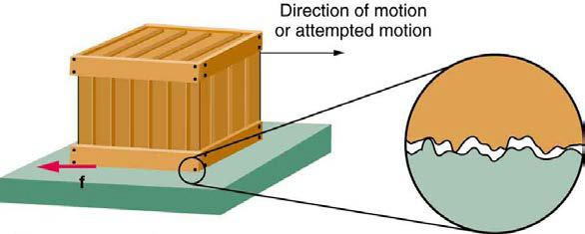
2-03 Friction
F = ma
Normal force – perpendicular to surface
Friction force – parallel to surface, and opposes motion
Comes from rough surface

Slide 27
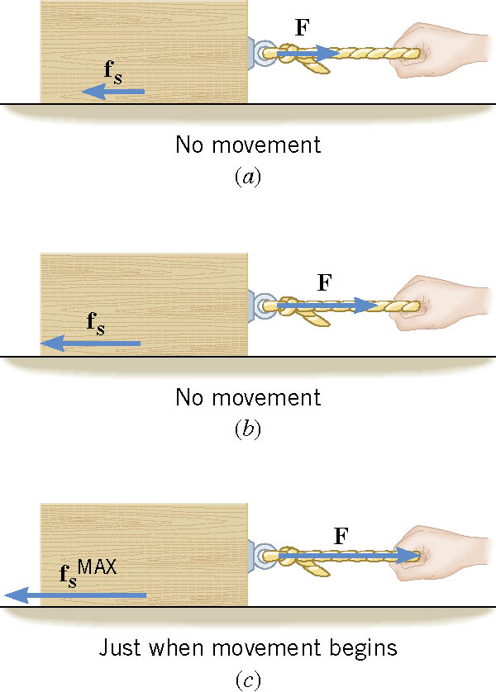
2-03 Friction
F = ma
Static Friction
  Keeps things from moving.
  Cancels out applied force until the applied force gets too big.
  Depends on force pushing down and roughness of surface

Slide 28

2-03 Friction
F = ma
Static Friction
    Depends on force pushing down and roughness of surface
  $f_{S}≤μ_{S}F_{N}$
  More pushing down (F_{N}), more friction
  $μ_{S}$ is coefficient of static friction (0.01 to 1.5)

Slide 29

2-03 Friction
F = ma
Kinetic Friction
  Once motion happens
  $f_{k}=μ_{k}F_{N}$
  $f_{k}$ is usually less than $f_{s}$

Slide 30
2-03 Friction
F = ma
A car skids to a stop after initially going 30.0 m/s. μ_{k} = 0.800. How far does the car go before stopping?
57.3 m
W
f_{k}
F_{N}
Notes:
$$y: F_{N}=W=mg$$
$$x: f_{k}=μ_{k}F_{N}=μ_{k}mg$$
$$F=ma$$
$$μ_{k}mg=ma→ μ_{k}g=a$$
$$v^{2}=v_{0}^{2}+2ax→ v^{2}=v_{0}^{2}+2μ_{k}gx$$
$$0={\left(30.0\frac{m}{s}\right)}^{2}+2\left(0.800\right)\left(−9.80\frac{m}{s^{2}}\right)x$$
$$−900 {\left(\frac{m}{s}\right)}^{2}=\left(15.7\frac{m}{s^{2}}\right)x → x=57.3 m$$

Slide 31





2-03 Friction
F = ma
A 65-kg skier is coasting downhill on a 15° slope. Assuming the coefficient of friction is that of waxed wood on snow, what is the skier’s acceleration?
$1.59 m/s^{2}$ downhill
$$F_{N}$$
$$f$$
$$15°$$
$$w$$
Notes:
Perpendicular direction:
$$F_{N}−w\cos{15°}=ma$$
$$F_{N}−mg\cos{15°}=m\left(0\right)$$
$$F_{N}−\left(65 kg\right)\left(9.8\frac{m}{s^{2}}\right)\cos{15°}=0$$
$$F_{N}=615.2948 N$$
parallel direction:
$$f−w\sin{15°}=ma$$
$$μ_{k}F_{N}−mg\sin{15°}=ma$$
$$\left(0.1\right)\left(615.2948 N\right)−\left(65 kg\right)\left(9.8\frac{m}{s^{2}}\right)\sin{15°}=\left(65 kg\right)a$$
$$−103.338 N=\left(65 kg\right)a$$
$$−1.59\frac{m}{s^{2}}=a$$

Slide 32
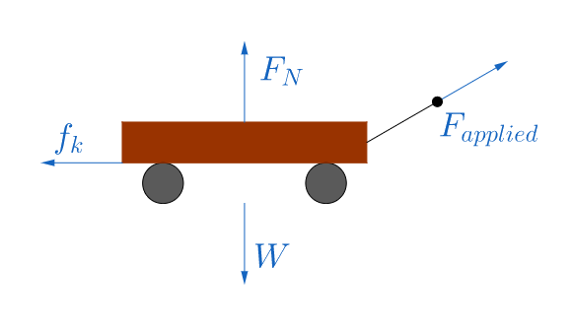
2-03 Friction
F = ma
While hauling firewood to the house, you pull a 100-kg wood-filled wagon across level ground at a constant velocity. You pull the handle with a force of 230 N at 30° above the horizontal. What is the coefficient of friction between the wagon and the ground?
Notes:
$$y:F_{N}−W+230 N sin 30°=ma$$
$$F_{N}−\left(100 kg\right)\left(9.8\frac{m}{s^{2}}\right)+115 N=\left(100 kg\right)\left(0\right)$$
$$F_{N}=865 N$$
$$x:230 N cos 30°−f_{k}=ma$$
$$199.1858 N−μ_{k}F_{N}=ma$$
$$199.1858 N−μ_{k}\left(865 N\right)=(100 kg)(0)$$
$$199.1858 N=\left(865 N\right)μ_{k}$$
$$μ_{k}=0.230$$

Slide 33
2-04 Tension, Hooke's Law, and Equilibrium
After this lesson you will…
Find spring force
Apply tension and spring force in force problems
Solve equilibrium force problems
F = ma
Notes:
OpenStax High School Physics 5.5, 4.3, 4.4
OpenStax College Physics 2e 4.5

Slide 34
2-04 Tension, Hooke's Law, and Equilibrium
F = ma
Do the lab on your worksheet

Slide 35
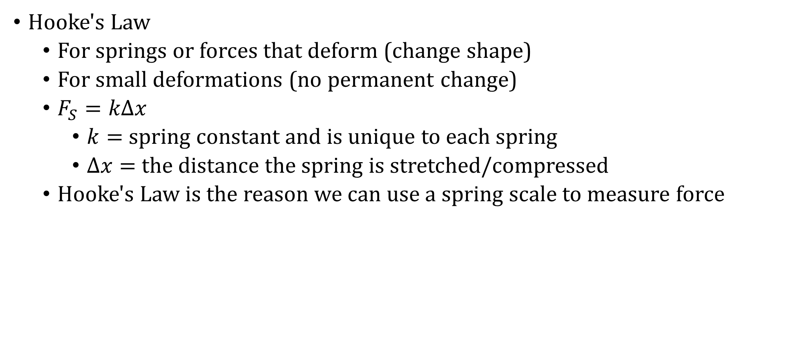
2-04 Tension, Hooke's Law, and Equilibrium
F = ma
Hooke's Law
  For springs or forces that deform (change shape)
  For small deformations (no permanent change)
  $F_{S}=kΔx$
    $k=$ spring constant and is unique to each spring
    $Δx=$ the distance the spring is stretched/compressed
  Hooke's Law is the reason we can use a spring scale to measure force

Slide 36
2-04 Tension, Hooke's Law, and Equilibrium
F = ma
Tension
  Pulling force from rope, chain, etc.
  Everywhere the rope connects to something, there is an identical tension

Slide 37

2-04 Tension, Hooke's Law, and Equilibrium
F = ma
Equilibrium
  No acceleration
  $F_{net}=ma$
  $F_{net}=0$

Slide 38
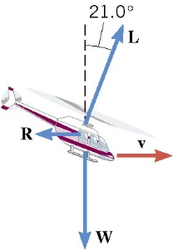
2-04 Tension, Hooke's Law, and Equilibrium
F = ma
The helicopter in the drawing is moving horizontally to the right at a constant velocity. The weight of the helicopter is 53,800 N. The lift force L generated by the rotating blade makes an angle of 21.0° with respect to the vertical. What is the magnitude of the lift force?
57600 N
Notes:
y-components
$$L cos 21.0°−W=ma$$
$$L\cos{21.0°}−53800 N=0$$
$$L\cos{21.0°}=53800 N$$
$$L=57600 N$$

Slide 39

2-04 Tension, Hooke's Law, and Equilibrium
F = ma
A stoplight is suspended by two cables over a street. Weight of the light is 110 N and the cables make a 122° angle with each side of the light. Find the tension in each cable.
104 N
T₁
T₂
122°
w
Notes:
$$Solve on board by making a table$$
$$F_{x}: T_{2}\cos{32°}−T_{1}\cos{32°}=0$$
$$T_{2}\left(.8480\right)−T_{1}\left(.8480\right)=0$$
$$T_{1}=T_{2}$$
$$F_{y}:−w+T_{1}\sin{32°}+T_{2}\sin{32°}=0$$
$$−110 N+T_{1}\left(.5299\right)+T_{2}\left(.5299\right)=0$$
$$−110 N+1.0598T_{1}=0$$
$$1.0598 T_{1}=110 N$$
$$T_{1}=T_{2}=103.8 N$$

Slide 40
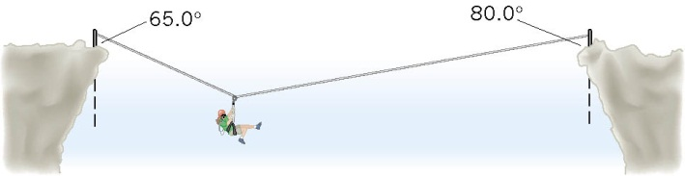
2-04 Tension, Hooke's Law, and Equilibrium
F = ma
A mountain climber, in the process of crossing between two cliffs by a rope, pauses to rest. She weighs 535 N. Find the tensions in the rope to the left and to the right of the mountain climber.
Notes:
x-direction
$$−T_{1}\sin{65°}+T_{2}\sin{80°}=ma=0$$
$$T_{2}=0.920289T_{1}$$
y-direction
$$T_{1}\cos{65°}+T_{2}\cos{80°}−w=ma=0$$
$$T_{1}\cos{65°}+\left(0.9202889T_{1}\right)\cos{80°}−535 N=0$$
$$0.582424777T_{1}=535 N$$
$$T_{1}=919 N$$
$$T_{2}=845 N$$

Slide 41
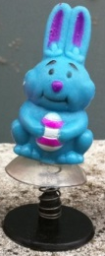
2-04 Tension, Hooke's Law, and Equilibrium
F = ma
A 10-g toy plastic bunny is connected to its base by a spring. The spring is compressed and a suction cup on the bunny holds it to the base so that the bunny doesn't move. If the spring is compressed 3 cm and has a constant of 330 N/m, how much force must the suction cup provide?
Notes:
$$F_{S}−w−F_{cup}=ma=0$$
$$kx−mg−F_{cup}=0$$
$$\left(330\frac{N}{m}\right)\left(0.03 m\right)−\left(0.010 kg\right)\left(9.8\frac{m}{s^{2}}\right)−F_{cup}=0$$
$$F_{cup}=9.8 N$$

Slide 42
2-05 Nonequilibrium and Fundamental Forces
After this lesson you will…
Know the fundamental forces
Solve nonequilibrium force problems
F = ma
Notes:
OpenStax High School Physics 4.3
OpenStax College Physics 2e 4.6-4.8

Slide 43
2-05 Nonequilibrium and Fundamental Forces
F = ma
Four Basic Forces
  All forces are made up of only 4 forces
  Gravitational - gravity
  Electromagnetic – static electricity, magnetism
  Weak Nuclear - radioactivity
  Strong Nuclear – keeps nucleus of atoms together

Slide 44
2-05 Nonequilibrium and Fundamental Forces
F = ma
All occur because particles with that force property play catch with a different particle
  Electromagnetic uses photons
  Scientists are trying to combine all forces together in Grand Unified Theory
  Have combined electric, magnetic, weak nuclear
Gravity is the weakest
  We feel it because the electromagnetic cancels out over large areas
Nuclear forces are strong but only over short distance
Notes:
Close on combining gravitational too

Slide 45
2-05 Nonequilibrium and Fundamental Forces
F = ma
A 1380-kg car is moving due east with an initial speed of 27.0 m/s. After 8.00 s the car has slowed down to 17.0 m/s. Find the magnitude and direction of the net force that produces the deceleration.
Notes:
Use kinematics to find a
$$v_{0}=27.0\frac{m}{s}, t=8.00 s, v=17.0\frac{m}{s}, a= ?$$
$$v=at+v_{0}$$
$$17\frac{m}{s}=a\left(8 s\right)+27\frac{m}{s}$$
$$a=−1.25\frac{m}{s^{2}}$$
Use Newton’s 2nd Law
$$F=ma$$
$$F=\left(1380 kg\right)\left(−1.25\frac{m}{s^{2}}\right)=−1725 N$$
1725 N West

Slide 46
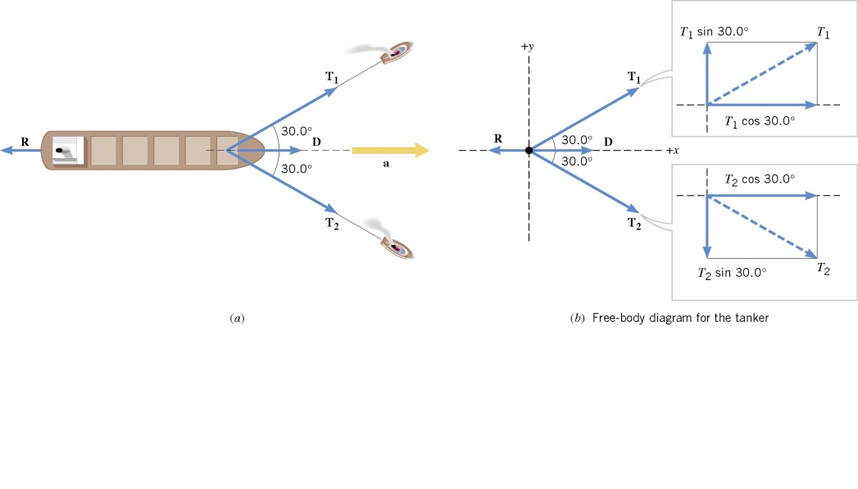
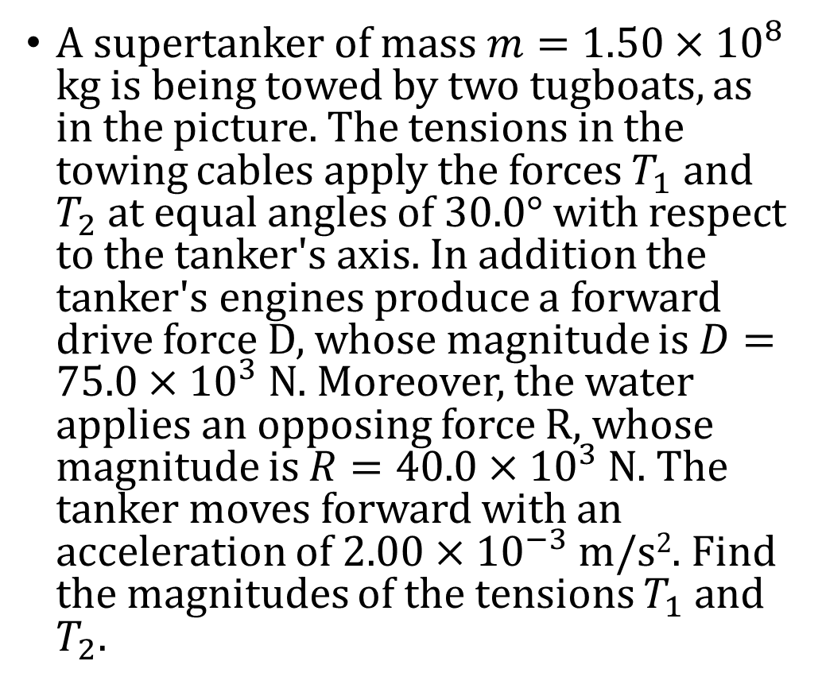
2-05 Nonequilibrium and Fundamental Forces
F = ma
A supertanker of mass $m=1.50×{10}^{8}$ kg is being towed by two tugboats, as in the picture. The tensions in the towing cables apply the forces $T_{1}$ and $T_{2}$ at equal angles of 30.0° with respect to the tanker's axis. In addition the tanker's engines produce a forward drive force D, whose magnitude is $D=75.0×{10}^{3}$ N. Moreover, the water applies an opposing force R, whose magnitude is $R=40.0×{10}^{3}$ N. The tanker moves forward with an acceleration of $2.00×{10}^{−3}$ m/s². Find the magnitudes of the tensions $T_{1}$ and $T_{2}$.
Notes:
$$F_{net}=ma$$
$$y:T_{1}\sin{30°}−T_{2}\sin{30°}=ma=0$$
$$T_{1}=T_{2}$$
$$x:T_{1}\cos{30°}+T_{2}\cos{30°}+D−R=ma$$
$$T_{1}\left(\frac{\sqrt{3}}{2}\right)+T_{1}\left(\frac{\sqrt{3}}{2}\right)+75×{10}^{3} N−40.0×{10}^{3} N=\left(1.50×{10}^{8} kg\right)\left(2.00×{10}^{−3}\frac{m}{s^{2}}\right)$$
$$\sqrt{3}T_{1}=2.65×{10}^{5} N$$
$$T_{1}=T_{2}=1.53×{10}^{5} N$$

Slide 47
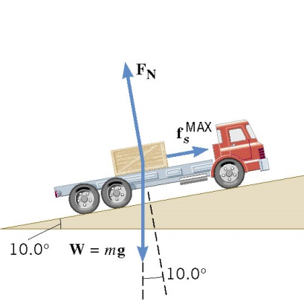

2-05 Nonequilibrium and Fundamental Forces
F = ma
A flatbed truck is carrying a crate up a 10.0° hill as in the picture. The coefficient of the static friction between the truck bed and the crate is $μ_{s}=0.350$. Find the maximum acceleration that the truck can attain before the crate begins to slip backward relative to the truck.
Notes:
$$F_{net}=ma$$
$$y:F_{N}−w\cos{10°}=ma=0$$
$$F_{N}=mg\cos{10°}$$
$$x:f_{s}−w\sin{10°}=ma$$
$$μ_{s}F_{N}−mg\sin{10°}=ma$$
$$0.350\left(mg\cos{10°}\right)−mg\sin{10°}=ma$$
$$1.68\frac{m}{s^{2}}=a$$

Slide 48
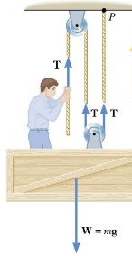
2-05 Nonequilibrium and Fundamental Forces
F = ma
A window washer on a scaffold is hoisting the scaffold up the side of a building by pulling downward on a rope, as in the picture. The magnitude of the pulling force is 540 N, and the combined mass of the worker and the scaffold is 155 kg. Find the upward acceleration of the unit.
Notes:
$$3T−w=ma$$
$$3\left(540 N\right)−\left(155 kg\right)\left(9.8\frac{m}{s^{2}}\right)=\left(155 kg\right)a$$
$$0.65\frac{m}{s^{2}}=a$$

